Slide 1


Pet Shelter
Pro
Ava McIntosh,
Cara Zozokos,
Hunter Mcintosh,
Gani Sagiev,
Ardalan Janpour

Slide 2
Business Case
01

Slide 3
The Problem
Pet shelters face challenges in efficiently managing adoption applications, tracking pets, and coordinating staff tasks.
Our application is targeted to help pet shelters handling high volumes of animals and adoption requests.

Slide 4


User Case
Our Category
XX%
Emma has been running her own animal shelter for 5 years. As the shelter grew, she got overwhelmed with the administrative work. Animals began to get overlooked, paperwork was getting lost, and coordinating adoptions felt like chaos.
Category C
XX%

Slide 5
The Solution
Emma needed a better way to manage the adoption process from applications to animals currently housed in their shelter.
The Animal Shelter Pro app aims to solve these challenges by providing a simple, all-in-one platform. It will manage staff, pets, applications and adoptees.

Slide 6
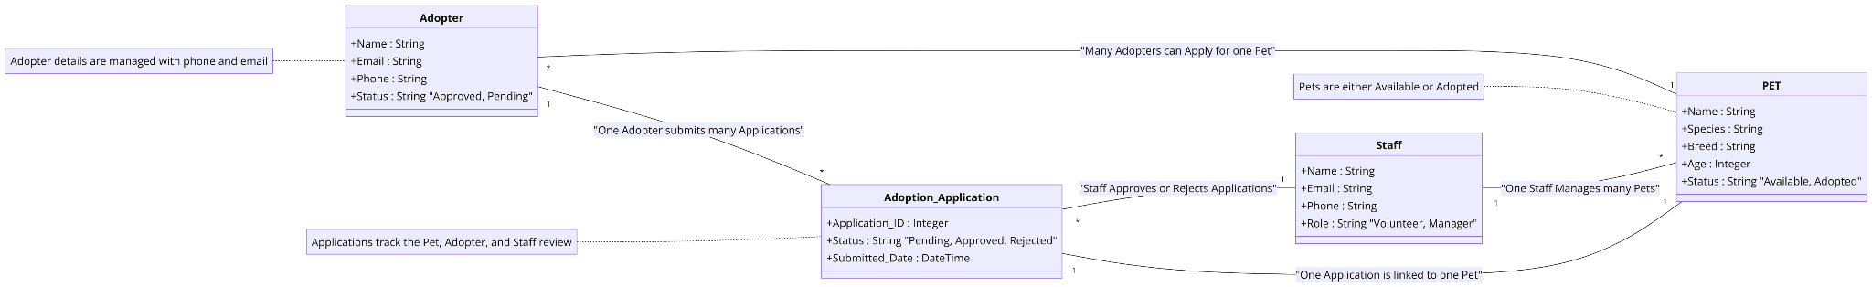
Conceptual Model

Slide 7
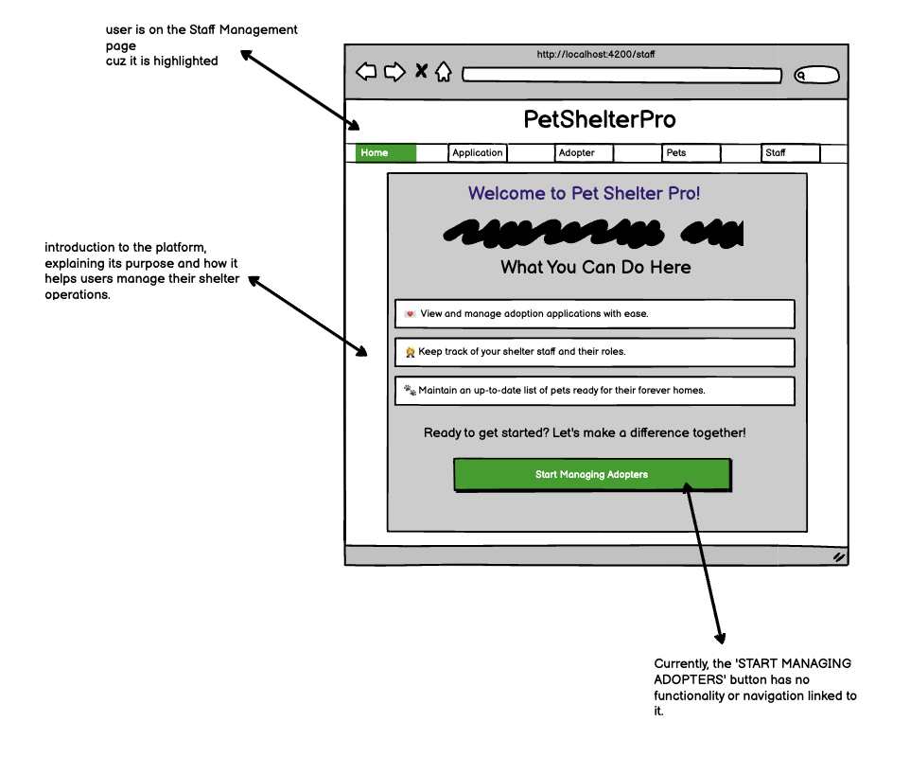
Wireframes
01
02
03
04

Slide 8
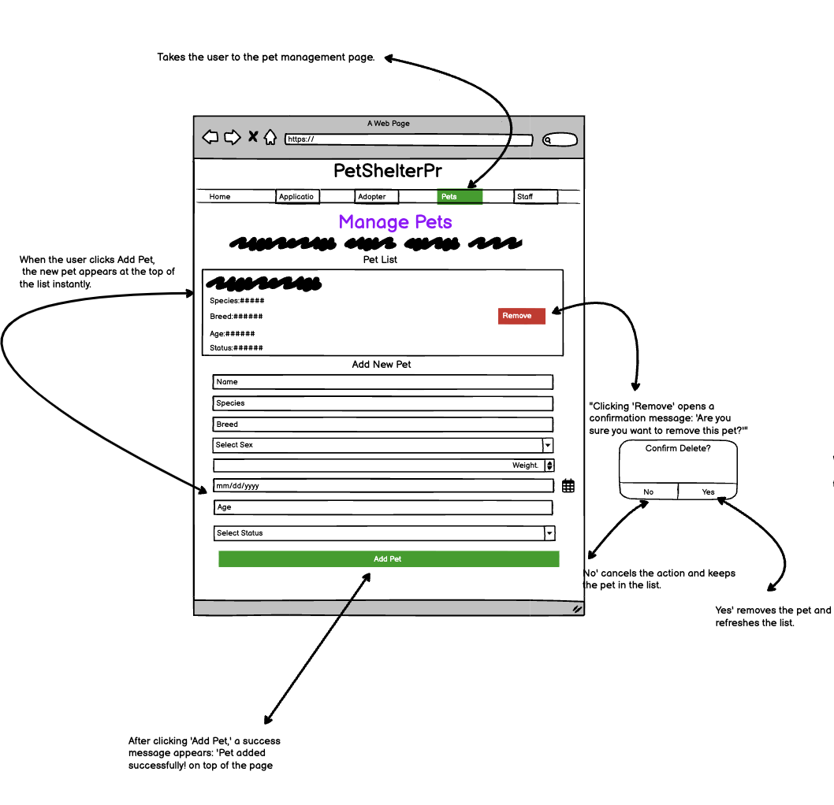
Wireframes
01
02
03
04
ddbnsd

Slide 9
Demo 1

Slide 10
Demo 2

